Slide 1


Problem Identification in Shop Floor Management Cycle (SFMC) at BOSCH Nashik Plant
Internship Duration: 2nd June 2025 – 31st November 2025
Presented by: Pradyumna Kulkarni PRN: 202201090099 Department: School of Mechanical Engineering.
Course : Semester Long Internship Program (SLIP)

Slide 2
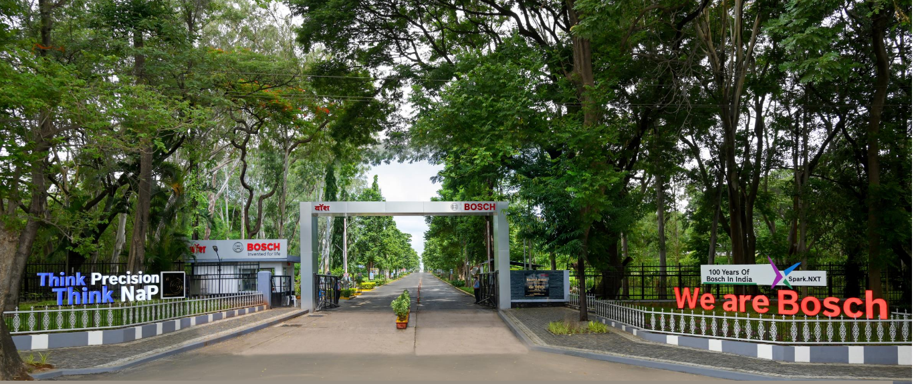
BOSCH Nashik

Slide 3
Introduction
I am Pradyumna Kulkarni, pursuing B tech in Mechanical engineering at MIT Academy of Engineering.
Currently interning at BOSCH India, in the MFC2 (Body Manufacturing).
Internship duration: 6 months (Completed 5 months so far).
Guided by:
Company Mentor: Mr. Sachin Bhandare
College Guide: R. A. Patil sir.

Slide 4
About the Company:
Founded in: 15 November 1886, Stuttgart, Germany
Headquarters: Gerlingen, Germany
Core Business Areas: Mobility Solutions, Industrial Technology, Consumer Goods (including power tools), and Energy and Building Technology
Global Presence: The Bosch Group comprises Robert Bosch GmbH and its roughly 490 subsidiary and regional companies in over 60 countries.

Slide 5
About the Company:
About Nashik Plant (NaP):
Name - Bosch Limited.
Address - Post Box No. 64 75, MIDC Estate Satpur, Trimbak Road 422 007, Nashik Maharashtra, India.
Industry Size - 400,000 sq. m.
Industry Type - Manufacturing Plant.
Annual Turnover - 26,827 Crores (3.1 Billion Euros).
Number of Employees - 1800 People.
Number of Plant -17 Manufacturing sites & 7 development and Application centers in India.
Main Product of the Plant : Fuel Injector

Slide 6
Internship Objectives:
Gain industry exposure in core Industrial principles and practices.
Apply classroom knowledge in real-world projects. (PDCA Cycle, Kaizens, 5S, Poka Yoke, etc)
Learn tools/software like [list tools]. : 7QC, 8D
Contribute to ongoing company projects.
Develop technical and soft skills.

Slide 7
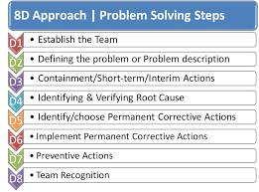
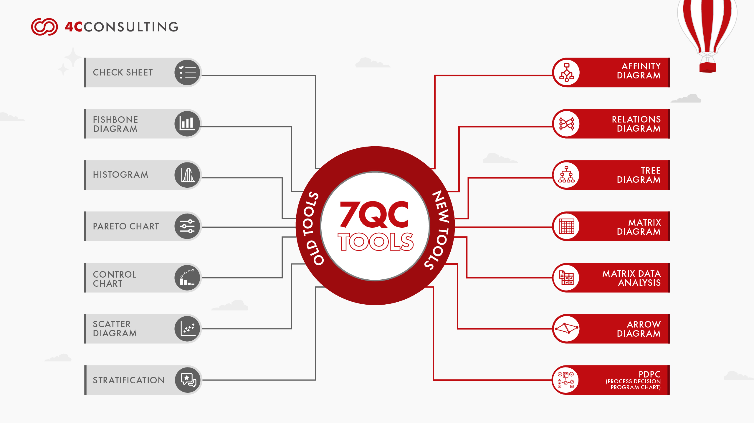
Tools being used so far:

Slide 8
Process flow
Turning
Drilling
(Inlet, 1.2,1,43,2,2)
A/F Milling
LPW-ECM-LPW
Thread Brushing
Induction Hardening
Phosphating
Thermal Deburring

Slide 9
Major Project – Overview
Title: Shop Floor Management Cycle (SFMC)
Background/Problem Statement:
Inefficient KPI Tracking: Key Performance Indicators (KPI) such as OEE, rejection rate, and cycle time were not being effectively monitored and reviewed at regular intervals.
Lack of Visibility & Accountability:Without a clear SFMC structure, roles and responsibilities on the shop floor were unclear, resulting in low accountability for daily performance.
Delayed Escalation & Problem-Solving: Problems on the shop floor were often escalated late due to the absence of tiered meetings and review cycles, leading to production losses.
Objective: Maximum optimization of Bottleneck Processes.

Slide 10
Layout:
PDCA
Line Takt
Hourly Monitoring Sheet
SFMC Cycle
PSS
(Problem Solving Sheet)
OEE Tracking
Attendance
OPL
Pareto Analysis

Slide 11
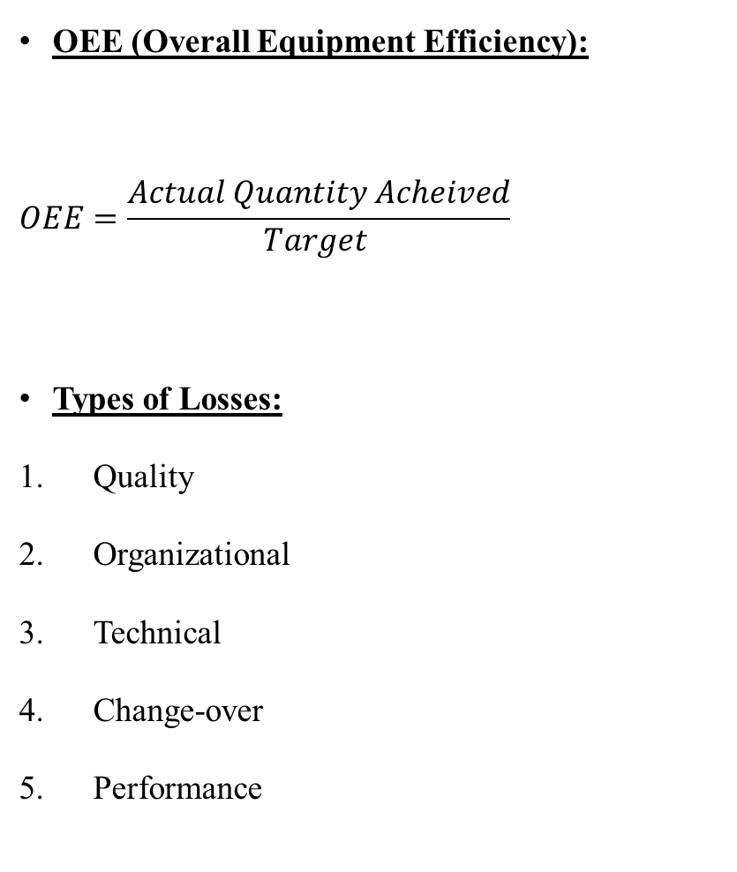
OEE (Overall Equipment Efficiency):
$$OEE=\frac{Actual Quantity Acheived}{Target }$$
Types of Losses:
Quality
Organizational
Technical
Change-over
Performance
Takt time chart:
Takt time
Customer Takt
(The time, Customer expects part to be made)
Actual Takt
(The time which is taken by machine for manufacturing the part)
Pareto Analysis

Slide 12
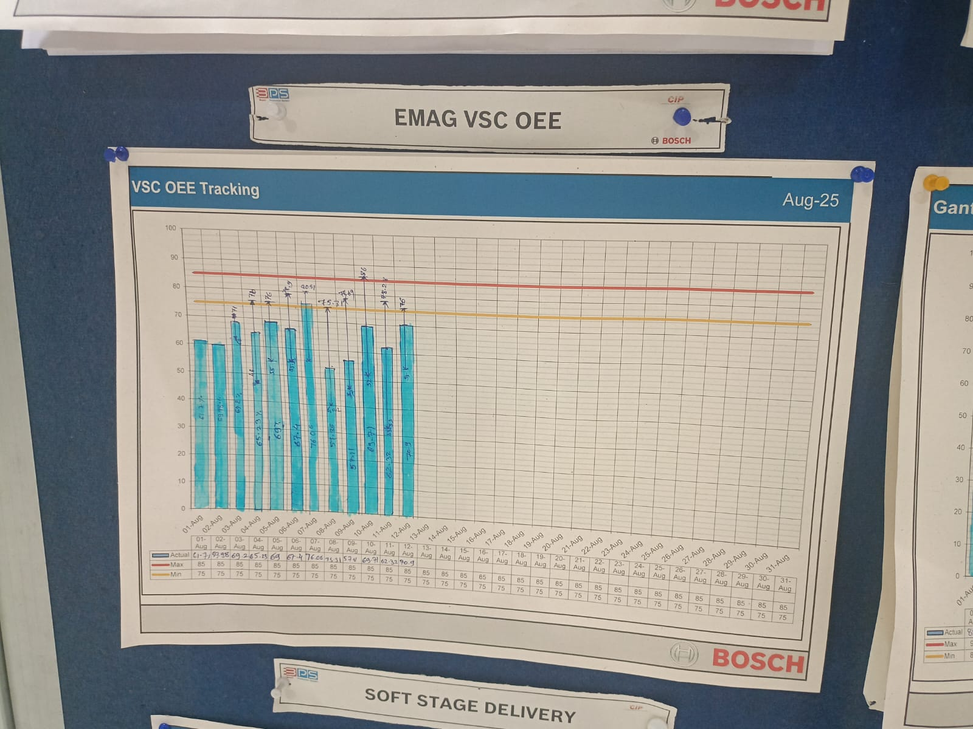

Slide 13
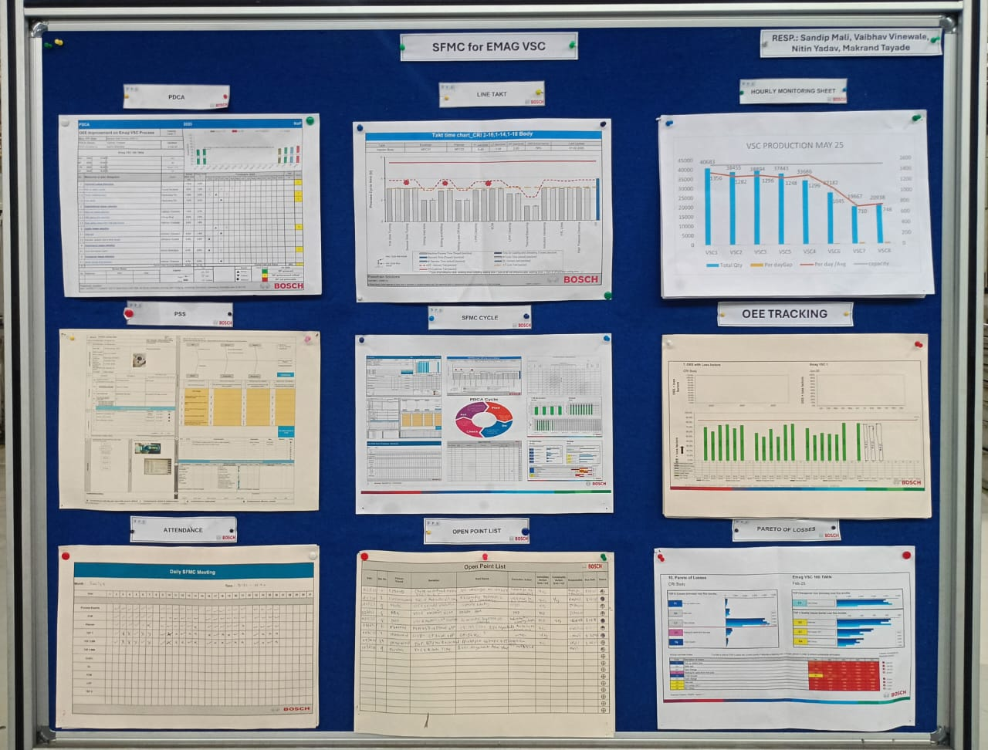
Actual SFMC Board

Slide 14
Project Outcomes:
Key outcomes:
Understanding and thorough investigation of the bottlenecks
Machine wise Performance Parameters understanding.
Quantity POV :
Target quantity got achieved due to effective use of visualization tools.(like Graphs which shows daily progress, daily meetings, etc.)
As target quantity was achievable with less difficulties, management and planning authorities were able to plan for bigger target in quantity.
Quality POV :
More Effectiveness in process flow and overall performance as Pareto analysis has been done.
Unnecessary scrap quantity reduced.
Benefits to company: Cost saving, efficiency improvement, more effective utilization of resources

Slide 15
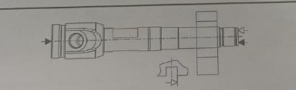
Minor Project(1)
Title: Inspection of trial parts for type 437.
Objective: To meet all the customer needs and requirements.
Work done:
A/F Height match check
T height check
Testing successful
200% Validation
Result/Impact:
Cost saving, IDC
Repair and Rework
Importance of Precision work
Risk Handelling.
A/F Milling Operation

Slide 16
Minor Project(2):
Detailed Scrap Tracking Analysis:
Monitoring the machine wise record for no. of scrapped parts
Segregating the part according to defect, the part have been scrapped.
Doing Decision making for machine for effective changes and avoiding further scrap.

Slide 17
Conclusion:
Successfully implemented a structured Shop Floor Management Cycle (SFMC) in the Body Department (MFC2)
Gained hands-on exposure to real-time production monitoring and KPI management
Improved visibility of production, quality, and downtime losses through visual management tools
Applied lean tools such as OEE tracking, Pareto analysis, PSS, OPL, and PDCA
Enhanced communication, teamwork, and professional discipline
The internship transformed theoretical knowledge into practical industrial competence through structured shop floor management.

